Slide 1
Helping Students with Visual Impairments Learn About Cells
Problem-Based Learning Project

Slide 2
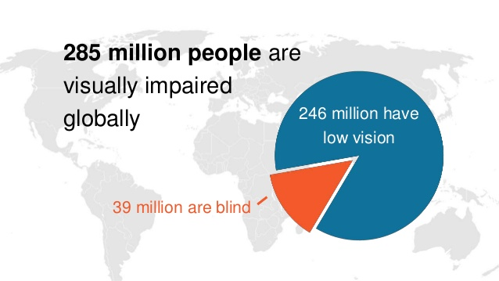
Visual Impairment Statistics
The Center for Disease Control in Atlanta states that…
More than 1 million people in the U.S. are legally blind
12 million people in the U.S. are visually impaired
The American Foundation for the Blind 2009 report that there are:
93,600 students who are visually impaired or blind;
55,200 students who are legally blind;
5,500 braille readers
International Center for Eye Health

Slide 3
Curriculum Standards
S7L2. Obtain, evaluate, and communicate information to describe how cell structures, cells, tissues, organs, and organ systems interact to maintain the basic needs of organisms.
a. Develop a model and construct an explanation of how cell structures (specifically the nucleus, cytoplasm, cell membrane, cell wall, chloroplasts, lysosome, and mitochondria) contribute to the function of the cell as a system in obtaining nutrients in order to grow, reproduce, make needed materials, and process waste. (Clarification statement: The intent is for students to demonstrate how the component structures of the cell interact and work together to allow the cell as a whole to carry out various processes. Additional structures, beyond those listed, will be addressed in high school Biology.)

Slide 4
Where’s the S.T.E.A.M.?
Science
Cell structure and function
Technology
Using technology to research content
Using technology to create a product (tactile, auditory, kinethetic)
Engineering
Product or lesson design
Art
Product creativity (fine arts)
Presentation of solution (language arts and fine arts)
Math
Statistics

Slide 5
Problem
Cells are..
the smallest unit of living things
mostly microscopic
usually studied with microscopes, animations, diagrams, and models
very complex and have many small structures that have specific functions
How can cells be studied by students with visual impairments?
Tactile learning
Auditory learning
Kinesthetic learning

Slide 6
Task
Scenario A = You are a designer for a company that specializes in producing instructional materials for students with visual impairments. You are creating an instructional product that will allow a teacher to effectively teach about cells and allow students with visual impairments to effectively learn about cells. What will you create? How will you market the product?
Scenario B = You are a concerned classmate. What can you do to facilitate learning for a student with a visual impairment in your science class? Is there a teaching method or activity that would help a student with a visual impairment learn more effectively about cells? What will you create? What will you teach in class?

Slide 7
Process
In order to create an appropriate and effective solution for a student with a visual impairment to learn about cells, you will need to learn about the following:
Cells (structures, functions, types)
Instructional Materials (types, uses, designs, costs)
Visual Impairment (definitions, causes, effects, physical adaptations)
Visual Impairment (lifestyle, learning styles, statistics)
Visual Impairment (role models, success stories, statistics)

Slide 8
Solutions
Scenario A – product designer
You will create a product that is usable by students with visual impairments in learning about cells.
You will create a marketing plan for your product.
Scenario B – concerned classmate
You will devise a plan to make learning easier, better, more accessible for a student with a visual impairment in the classroom.
You will teach a lesson in class and evaluate the results of that lesson.

Slide 9
Work in Progress – What do we need to know?
…About Cells
What are cells? What are the characteristics of cells? What are the functions of cells?
…About Students with Visual Impairment
What is a visual impairment? What are the characteristics of visual impairment?
What are the challenges for learning with a visual impairment? What are the learning needs of students with visual impairments?
How do students with visual impairments learn? What are the strategies for learning for students with visual impairments?
How do students with visual impairments interact with teachers and other students when learning?
Statistics – How many…? How much…? How great is the need for VI products/lessons?

Slide 10
Work in Progress – How will we find out?
Class work assignments including, but not limited to…
Cornell notes, vocabulary, quizzes
labs and hands-on activities
research of print and digital resources
interviewing primary sources
hosting guest speakers

Slide 11
Research Resources
Project Ideal
Texas School for the Blind and Visually Impaired
Teaching Students with Visual Impairments
American Printing House for the Blind
Cobb Digital Library
Britannica Encyclopedia
Gale (research in context and virtual reference library)
Galileo (teen and advanced)
Science in Context

Slide 12
Video and Other Resources
Teaching Students with Visual Impairments
Classroom Tools for Visually Impaired Students
Touch, Hear, Play, Learn – Play Spaces for the Visually Impaired
Lost Mountain Middle School VI Unit guest speaker

Slide 13
Work in Progress – What have we found out?
To be completed as we progress through the project…
class work assignments
class discussions
content quizzes
project checkpoints

Slide 14
Final Product
Checklist rubric
Self assessment
Peer assessment

